Slide 1
MUSIC DATA ANALYSIS
ACAR ERDINC

Slide 2
OUTLINE
Motivation
Data
  Obtaining the data
  Parameters & Statistics
  Missing Values & Noise
  Data Cleaning
Tools Used
Methods and Algorithms Used
Current Results
Feature Work

Slide 3

MOTIVATION
The ultimate goal of this project is to obtain an understanding about patterns in music taste of people.
What good is this understanding?
  Can predict if a person would like a new song or not.
  Can suggest new artists and tracks similar to one’s music taste.
  Can find customer targets for advertisement.
And, I’m personally in to music.

Slide 4
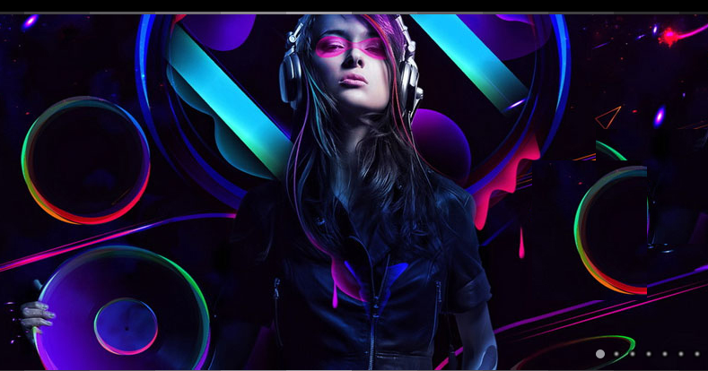
DATA

Slide 5
OBTAINING THE DATA
KAGGLE: “We’re making data science a sport.™”
Competition URL: http://www.kaggle.com/c/MusicHackathon
It contains personal information about people living in England, their music preferences and words that they used to describe a sample music.

Slide 6
PARAMETERS
THERE ARE MANY! To be precise, 110 parameters are present.
Two tables:
  User (28416)
  Words (118301)

Slide 7
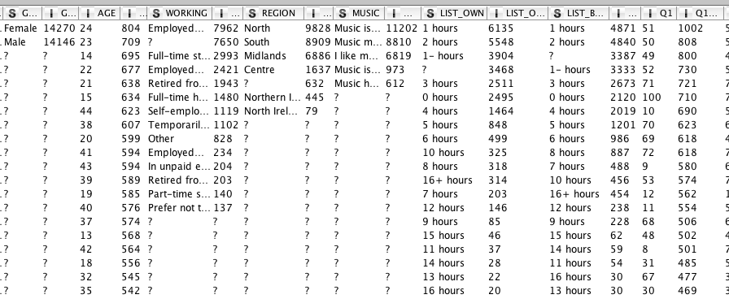
Parameters
USER TABLE

Slide 8
Parameters
Working
Employed 30+ hours a week
Full-time student
Employed 8-29 hours per week
Retired from full-time employment (30+ hours per week)
Full-time housewife / househusband
Self-employed
Temporarily unemployed
Other
Employed part-time less than 8 hours per week
In unpaid employment (e.g. voluntary work)
Retired from self-employment
Part-time student
Prefer not to state
?
Music
Music is important to me but not necessarily more important than other hobbies or interests
Music means a lot to me and is a passion of mine
I like music but it does not feature heavily in my life
Music is no longer as important as it used to be to me
Music has no particular interest for me

Slide 9
Parameters
User Questions:
  I enjoy actively searching for and discovering music that I have never heard before
  I find it easy to find new music
  I am constantly interested in and looking for more music
  I would like to buy new music but I don’t know what to buy
  I used to know where to find music
  I am not willing to pay for music
  I enjoy music primarily from going out to dance
  Music for me is all about nightlife and going out
  I am out of touch with new music
  My music collection is a source of pride
  Pop music is fun
  Pop music helps me to escape
  I want a multi media experience at my fingertips wherever I go
  I love technology
  People often ask my advice on music - what to listen to
  I would be willing to pay for the opportunity to buy new music pre-release
  I find seeing a new artist / band on TV a useful way of discovering new music
  I like to be at the cutting edge of new music
  I like to know about music before other people

Slide 10
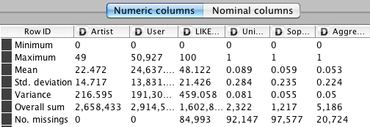
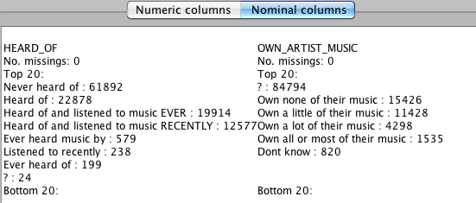
PARAMETERS
WORDS TABLE

Slide 11
parameters
Words:
Uninspired, Sophisticated, Aggressive, Edgy, Sociable, Laid back, Wholesome, Uplifting, Intriguing, Legendary, Free, Thoughtful, Outspoken, Serious, Good lyrics, Unattractive, Confident, Old, Youthful, Boring, Current, Colourful, Stylish, Cheap, Irrelevant, Heartfelt, Calm, Pioneer, Outgoing, Inspiring, Beautiful, Fun, Authentic, Credible, Way out, Cool, Catchy, Sensitive, Mainstream, Superficial, Annoying, Dark, Passionate, Not authentic, Good Lyrics, Background, Timeless, Depressing, Original, Talented, Worldly, Distinctive, Approachable, Genius, Trendsetter, Noisy, Upbeat, Relatable, Energetic, Exciting, Emotional, Nostalgic, None of these, Progressive, Sexy, Over, Rebellious, Fake, Cheesy, Popular, Superstar, Relaxed, Intrusive, Unoriginal, Dated, Iconic, Unapproachable, Classic, Playful, Arrogant, Warm, Soulful

Slide 12
MISSING VALUES & NOISE
Missing values were not modified in the data,
they got handled during analysis.
  For many cases, there were parameters without missing values being used.
  For the other cases, rows with the missing values were removed.
There were some noise or corruption in the data,
they got handled before the analysis manually.
  Described in more detail on the next part.

Slide 13
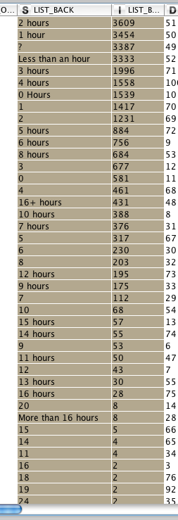
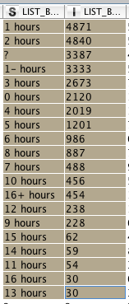
DATA CLEANING
Several manual modifications were made on the data before the analysis.

Slide 14
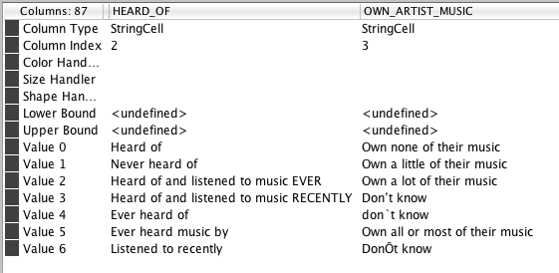
DATA CLEANING

Slide 15
DATA CLEANING
Rounded Question answers for User Table.
Resolved parameter inconsistency in Words Table.

Slide 16
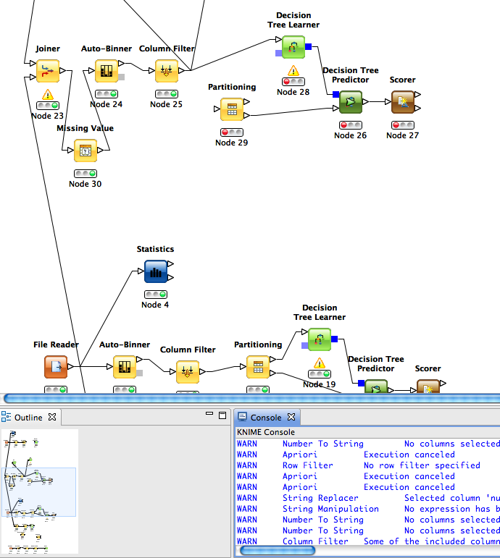
TOOLS USED
KNIME
Weka Package for Knime
Excel & Textedit

Slide 17
Methods and Algorithms Used
Decision Trees: C4.5, J48
Regression Trees: M5P
Clustering: k-Means
Association Rules: Apriori

Slide 18
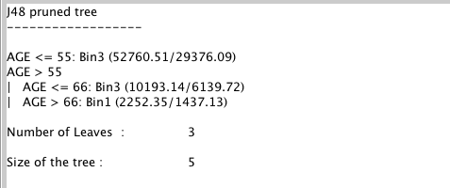
CURRENT RESULTS
Willingness to pay for music based on age:
Bin1: very likely, Bin2: neutral, Bin3: very unlikely

Slide 19
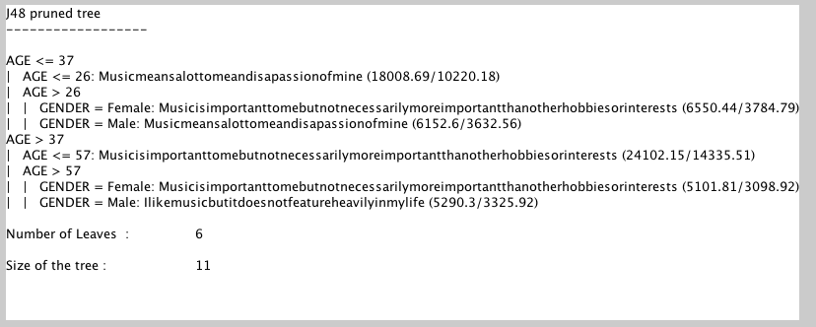
CURRENT RESULTS
Passion for music based on age and gender:
Significant drop of interest by males as they age.

Slide 20
CURRENT RESULTS
Enjoy music from going out to dance(q7) likeliness
AGE <= 38
| AGE <= 30
| | AGE <= 17
| | | GENDER = Female
| | | | AGE <= 14: Bin1 (1348.28/911.3)
| | | | AGE > 14: Bin2 (1154.37/709.86)
| | | GENDER = Male: Bin1 (2856.52/1645.6)
| | AGE > 17
| | | WORKING = Employed30hoursaweek
| | | | AGE <= 23: Bin3 (2159.98/1451.78)
| | | | AGE > 23
| | | | | GENDER = Female: Bin3 (2026.75/1348.21)
| | | | | GENDER = Male: Bin1 (2429.11/1631.77)
| | | WORKING = Full-timestudent
| | | | GENDER = Female
| | | | | AGE <= 20: Bin3 (1209.23/780.46)
| | | | | AGE > 20: Bin2 (1035.68/702.71)
| | | | GENDER = Male: Bin1 (2279.89/1522.85)
| | | WORKING = Temporarilyunemployed: Bin1 (1273.44/810.81)
| AGE > 30
| | GENDER = Female
| | | AGE <= 34: Bin2 (2348.22/1494.8)
| | | AGE > 34: Bin1 (2634.81/1684.67)
| | GENDER = Male: Bin1 (4805.09/2951.32)
AGE > 38: Bin1 (33098.42/15675.13)

Slide 21
CURRENT RESULTS
Nightlife tendency(q8) based on various parameters
AGE <= 33
| AGE <= 17: Bin1 (5359.18/2889.45)
| AGE > 17
| | WORKING = Employed30hoursaweek
| | | AGE > 23
| | | | GENDER = Female
| | | | | AGE <= 26: Bin2 (932.28/611.58)
| | | | GENDER = Male: Bin1 (3692.56/2379.47)
| | WORKING = Employed8-29hoursperweek
| | | AGE > 22: Bin1 (1705.71/1023.3)
| | WORKING = Full-timehousewifehousehusband
| | | AGE <= 27: Bin1 (599.59/385.51)
| | | AGE > 27
| | | | AGE <= 29: Bin2 (158.1/92.61)
| | | | AGE > 29: Bin1 (440.23/247.88)
| | WORKING = Full-timestudent
| | | GENDER = Female: Bin1 (2263.38/1422.64)
| | | GENDER = Male
| | | | AGE <= 23
| | | | | AGE <= 21
| | | | | | AGE <= 19: Bin2 (879.12/547.87)
| | | | | | AGE > 19: Bin1 (675.26/415.01)
| | WORKING = Temporarilyunemployed: Bin1 (1427.86/832.31)
AGE > 33: Bin1 (39385.8/15949.74)

Slide 22
CURRENT RESULTS
Pop music tendency (q12) based on age and gender:
AGE <= 55: Bin3 (52760.51/29376.09)
AGE > 55
| AGE <= 66: Bin3 (10193.14/6139.72)
| AGE > 66
| | AGE <= 72
| | | GENDER = Female: Bin3 (837.47/542.18)
| | | GENDER = Male: Bin1 (786.64/510.55)
| | AGE > 72: Bin1 (628.23/355.06)

Slide 23
CURRENT RESULTS
Willingness to pay for pre-releases (q16):
AGE <= 30
| AGE <= 16: Bin3 (3943.4/2570.87)
| AGE > 16
| | GENDER = Female
| | | WORKING = Employed30hoursaweek: Bin2 (2507.35/1690.75)
| | | WORKING = Employed8-29hoursperweek: Bin2 (1050.96/690.32)
| | | WORKING = Full-timehousewifehousehusband: Bin2 (678.68/442.19)
| | | WORKING = Full-timestudent: Bin1 (2049.81/1394.01)
| | | WORKING = Temporarilyunemployed: Bin2 (471.68/323.43)
| | GENDER = Male
| | | WORKING = Employed30hoursaweek: Bin3 (3109.58/2129.01)
| | | WORKING = Employed8-29hoursperweek: Bin2 (650.77/445.67)
| | | WORKING = Full-timestudent: Bin3 (2067.44/1429.1)
| | | WORKING = Temporarilyunemployed: Bin2 (584.25/370.76)
AGE > 30
| AGE <= 40: Bin2 (10356.09/6829.93)
| AGE > 40: Bin1 (24975.85/12709.77)

Slide 24
CURRENT RESULTS
Most frequent subsets for words:
Minimum support: 0.01 (1183 instances)
Minimum metric <confidence>: 0.5
Number of cycles performed: 20
Best rules found:
1. Beautiful=1 Timeless=1 Original=1 Distinctive=1 1552 ==> Talented=1 1334 conf:(0.86)
2. Beautiful=1 Authentic=1 Timeless=1 Original=1 1399 ==> Talented=1 1202 conf:(0.86)
3. Beautiful=1 Passionate=1 Original=1 Distinctive=1 1419 ==> Talented=1 1219 conf:(0.86)
4. Stylish=1 Beautiful=1 Original=1 Distinctive=1 1400 ==> Talented=1 1197 conf:(0.86)
5. Current=1 Fun=1 Upbeat=1 Energetic=1 1462 ==> Catchy=1 1247 conf:(0.85)
6. Fun=1 Cool=1 Upbeat=1 Energetic=1 1405 ==> Catchy=1 1195 conf:(0.85)
7. Beautiful=1 Credible=1 Original=1 Distinctive=1 1467 ==> Talented=1 1246 conf:(0.85)
8. Stylish=1 Credible=1 Original=1 Distinctive=1 1494 ==> Talented=1 1267 conf:(0.85)
9. Authentic=1 Credible=1 Timeless=1 Original=1 1491 ==> Talented=1 1260 conf:(0.85)
10. Fun=1 Talented=1 Upbeat=1 1767 ==> Catchy=1 1491 conf:(0.84)

Slide 25
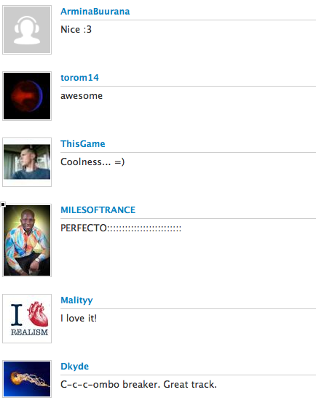

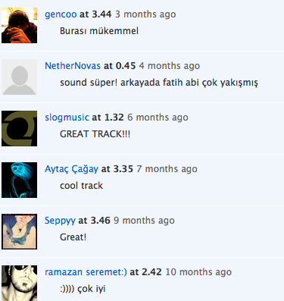

Current results
What good is this information?

Slide 26
Feature work
Analysis will be further tested with different algorithms.
New and interesting analysis will be tried to be obtained.
Might include anonymous parameters for a classification.

Slide 27
Thanks
Thank you for listening.
My(Expert’s) last.fm page: http://www.last.fm/user/thisiserdinc
QUESTIONS?

